Slide 1

Film Search Engine
Natural-Language Movie Discovery, Built for Speed & Precision
A powerful search engine that understands natural language queries like "90s sci-fi with Tom Hanks" and delivers fast, relevant results. Runs entirely locally with zero external API costs, indexing ~9.7k movies and returning results in under 2 seconds.

Slide 2
The Problem: Keyword Search Falls Short
Why Traditional Search Fails
Common Use Cases
Keyword-based movie search struggles with user intent. When someone searches for "90s sci-fi with Tom Hanks," traditional systems can't distinguish between actors, directors, genres, and time periods—they just match words.
"horror thriller films from the late 90s starring Keanu Reeves before 2000"
"war drama movies about love in the mid 80s with Tom Cruise”
"funny comedy films from 2010-2015 featuring Will Smith and directed by someone"
Users today expect natural-language queries with precise filtering. They want to find "funny films from the early 2000s" or "horror movies directed by Wes Craven" without learning complex syntax.
The technical challenge: extract entities (actors, directors), parse date ranges accurately, and perform semantic retrieval that goes beyond simple keyword matching.

Slide 3
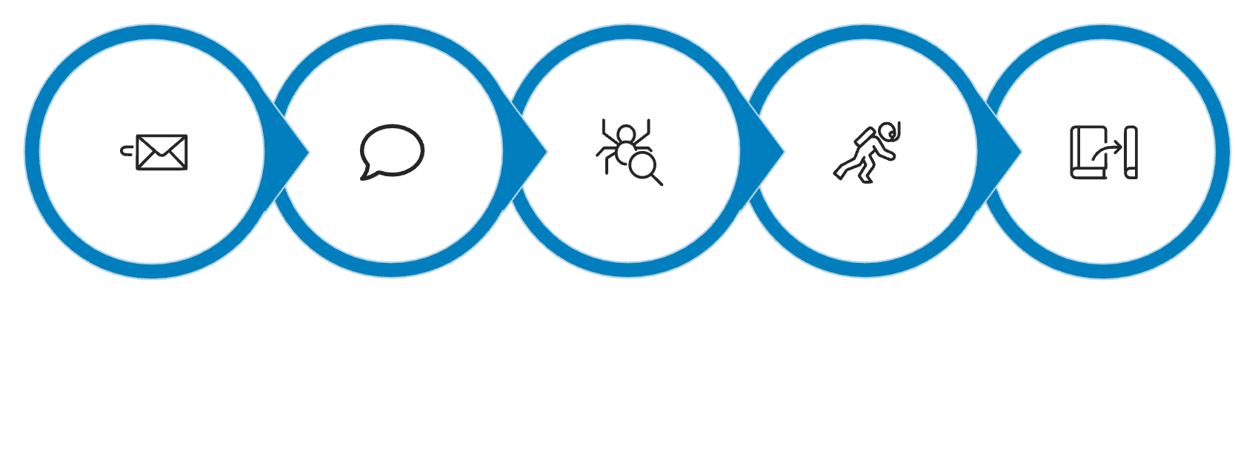







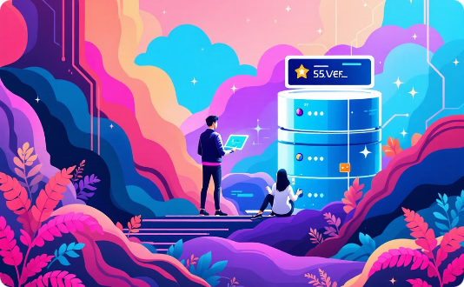
System Architecture
Query Input
Understand
Search
Rank
Results
Core Components
Parser
Embeddings
Search & Serve
spaCy NER for person recognition, regex for decade parsing, synonym mapping
all-MiniLM-L6-v2 model generating 384-dim normalized vectors
FAISS IndexFlatIP for vector search, FastAPI backend, Streamlit UI

Slide 4

Data Pipeline: From Raw to Searchable
01
02
Ingest Data
Data Pre-Processing
Load ~9.7k movies from JSONL format with complete metadata
Lowercase, trim whitespace, map genre synonyms (sci-fi → Science Fiction)
03
04
Weight & Combine
Structure
Build searchable text: title×3, genres×2, director×2, actors×2, overview×1
Output clean Movie objects with weighted searchable_text ready for embedding
Why weighting matters: By repeating important fields like title and genres multiple times in the searchable text, we ensure the embedding model "hears" these critical attributes more strongly, leading to better semantic matches.

Slide 5
Query Understanding: Parsing Natural Language
Extracting Intent from Text
Technical Implementation
The query parser breaks down natural language into structured components the search engine can act on. It recognizes who (actors and directors), when (time periods and specific years), and what (genres and themes).
Decade parsing: Handles '90s, '80s with smart century detection (00-29 → 2000s, 30-99 → 1900s)
Range detection: "early/mid/late" subdivisions, explicit ranges, before/after operators
Using spaCy's named entity recognition, we identify person names and fuzzy-match them against our database. Regex patterns handle complex date expressions like "90s" (→ 1990-1999), "early 2000s" (→ 2000-2003), "before 2000", and "after 2010".
Entity matching: Fuzzy string matching for misspellings and variations
Example Parse
"90s sci-fi with Tom Hanks"
→ actors=[tom hanks]→ genres=[science fiction]→ year_range=(1990, 1999)

Slide 6
Embeddings: Capturing Semantic Meaning
From Text to Vectors
Fast Retrieval with FAISS
Every movie's searchable text is transformed into a 384-dimensional vector using the all-MiniLM-L6-v2 model. These embeddings capture semantic meaning—movies with similar themes, actors, or styles cluster together in vector space.
Facebook's FAISS library provides the vector search infrastructure. We use IndexFlatIP (inner product index) for exact nearest-neighbor search—accurate and fast enough for ~10k movies.
We normalize all vectors to unit length, enabling fast cosine similarity via simple inner product computation. This mathematical trick makes comparisons blazingly fast.
Persistence is key: We save the built index and embeddings to disk, eliminating rebuild time on subsequent startups and enabling true offline operation.
384
9.7K
<2s
Vector Dimensions
Movies Indexed
Query Latency
Compact representation balancing expressiveness and speed
Complete searchable catalog ready for queries
Sub-second response time for most searches

Slide 7
Hybrid Ranking: Relevance Meets Precision
Multi-Factor Scoring for Optimal Results
Raw semantic similarity isn't enough—we combine multiple signals to surface the most relevant results while respecting user constraints. Our hybrid scoring system balances semantic understanding with strict filtering and quality signals.
Semantic Similarity
Strict Filters
Quality Signals
Cosine similarity between query and movie embeddings—the core relevance signal
Movies must match ALL actors, ANY director, and fall within year range
Normalized rating and popularity scores act as gentle tie-breakers
The Scoring Formula
Final Score = w_semantic × similarity + w_match × filter + w_rating × norm_rating + w_pop × norm_popularity
Weights are tuned to prioritize semantic relevance while ensuring user constraints are never violated. Filtering happens before scoring to eliminate impossible matches early.

Slide 8
Delivering Results: API & Interface
RESTful API Design
Streamlit Demo UI
A simple, powerful API makes integration effortless. The /search endpoint accepts natural language queries and returns ranked results with complete metadata.
An intuitive interface showcases the engine's capabilities. Users enter queries, view poster grids, inspect scores, and explore movie details—all in real-time.
The UI demonstrates how quickly results load and how accurately the system interprets complex queries.
GET /search?q=90s+action+with+Keanu+Reeves&top_k=10
Responses include movie details, relevance scores, and similarity metrics. A health endpoint ensures service availability, and local mode loads persisted indexes for instant startup.
Response Schema
Movie metadata (title, year, genres, cast, director)
Relevance score and semantic similarity
Poster URL and additional details

Slide 9

Traceability & Debugging
Transparent, Debuggable Pipeline
Every query generates detailed logs showing exactly what the system understood and why specific results were chosen. This transparency builds trust and enables rapid iteration on ranking algorithms.
Input Normalization
1
Logs show the cleaned query text and initial parsing
2
Entity Extraction
PERSON matches with fuzzy scores: "wes cravin" → "wes craven" (score: 0.95)
Date Parsing
3
Decade resolution: "90s" → (1990, 1999)
4
Candidate Filtering
Reasons for inclusion/exclusion based on year, actor, and director constraints
Final Ranking
5
Top results with semantic similarity and composite scores
Example log insight: "Candidate excluded: year 1985 outside range (1990-1999)" clearly shows why a movie didn't make the cut, making it easy to diagnose unexpected results.

Slide 10
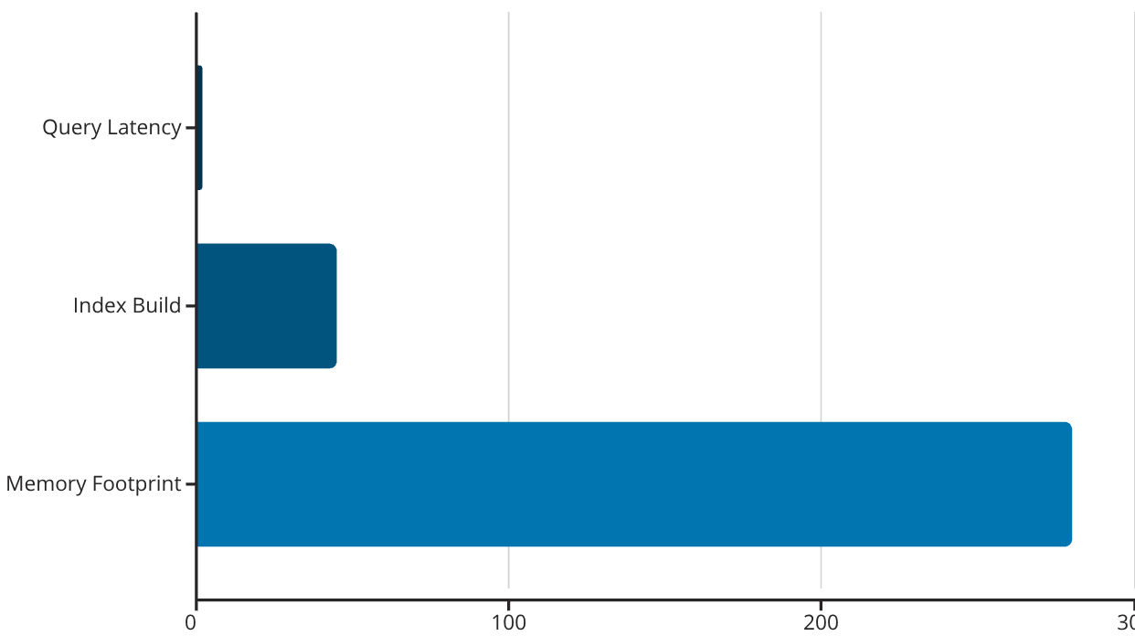



Performance & Future Roadmap
Current Performance
What's Next
Near-Term
Hybrid BM25+vector search, faceted filtering, query caching, "More like this" feature
Mid-Term
Personalization engine, learn-to-rank models, multilingual query support
Sub-2-second queries, ~280MB memory footprint, offline-capable with persisted indexes. First run includes model warm-up; subsequent queries leverage cached artifacts.
Long-Term
Distributed vector infrastructure (pgvector/Elasticsearch), FAISS-GPU, IVF/HNSW indexing for millions of movies
Current limitations include typo sensitivity, lack of personalization, and single-node scaling. Mitigations are in place via caching and controlled upgrades, with a clear path to enterprise-scale deployment.

Slide 11
Pre-Defined Questionnaires
Technical Queries
Business Queries
Can it personalize results for users (preferences, watch history)?
A: Deploy a preference-based reranker leveraging behavioral signals to lift CTR and engagement while enforcing relevance guardrails.
Could we support hybrid sparse + dense retrieval and reranking?
A: Yes, by fusing BM25 with embeddings and reranking the merged top-N using a lightweight cross-encoder for precision.
How would we scale to millions of items ?
A: Use FAISS IVF/HNSW or a vector DB (Milvus/Weaviate), shard the index, and tune nprobe/ef for high‑recall low‑latency at scale.
Will it support more languages and colloquial phrasing?
A: Roll out multilingual capability with language detection and localized taxonomies to expand market reach with consistent experience quality.
How can we improve parsing robustness ?
A: Add curated lexicons + spaCy EntityRuler, stronger/finetuned NER, richer regex/patterns, and multilingual embeddings with language routing.
Can it explain 'why' a result was shown (transparent scoring/explanations)?
A: Provide clear, human-readable justification (score breakdown and matched attributes) to build trust and improve conversion.
What observability/metrics will we add ?
A: Capture parse/embed/search/rank latencies, candidate/filtered counts, errors, recall/CTR; add OpenTelemetry tracing and drift/quality alerts.
What would it take to move from demo to production (scalability, monitoring, SLAs, cost)?
A: Productionize with scalable ANN infrastructure, autoscaling and SLAs, comprehensive monitoring and security, and cost efficiency via compression/right-sizing.

Slide 12
Q&A
Have any questions? Feel Free to ask !

Slide 13
The END

